Slide 1
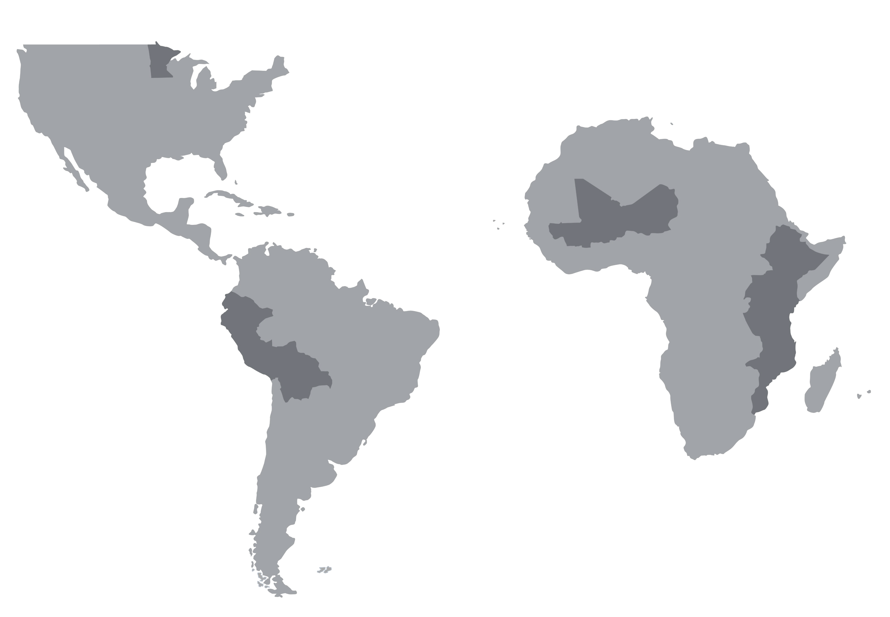
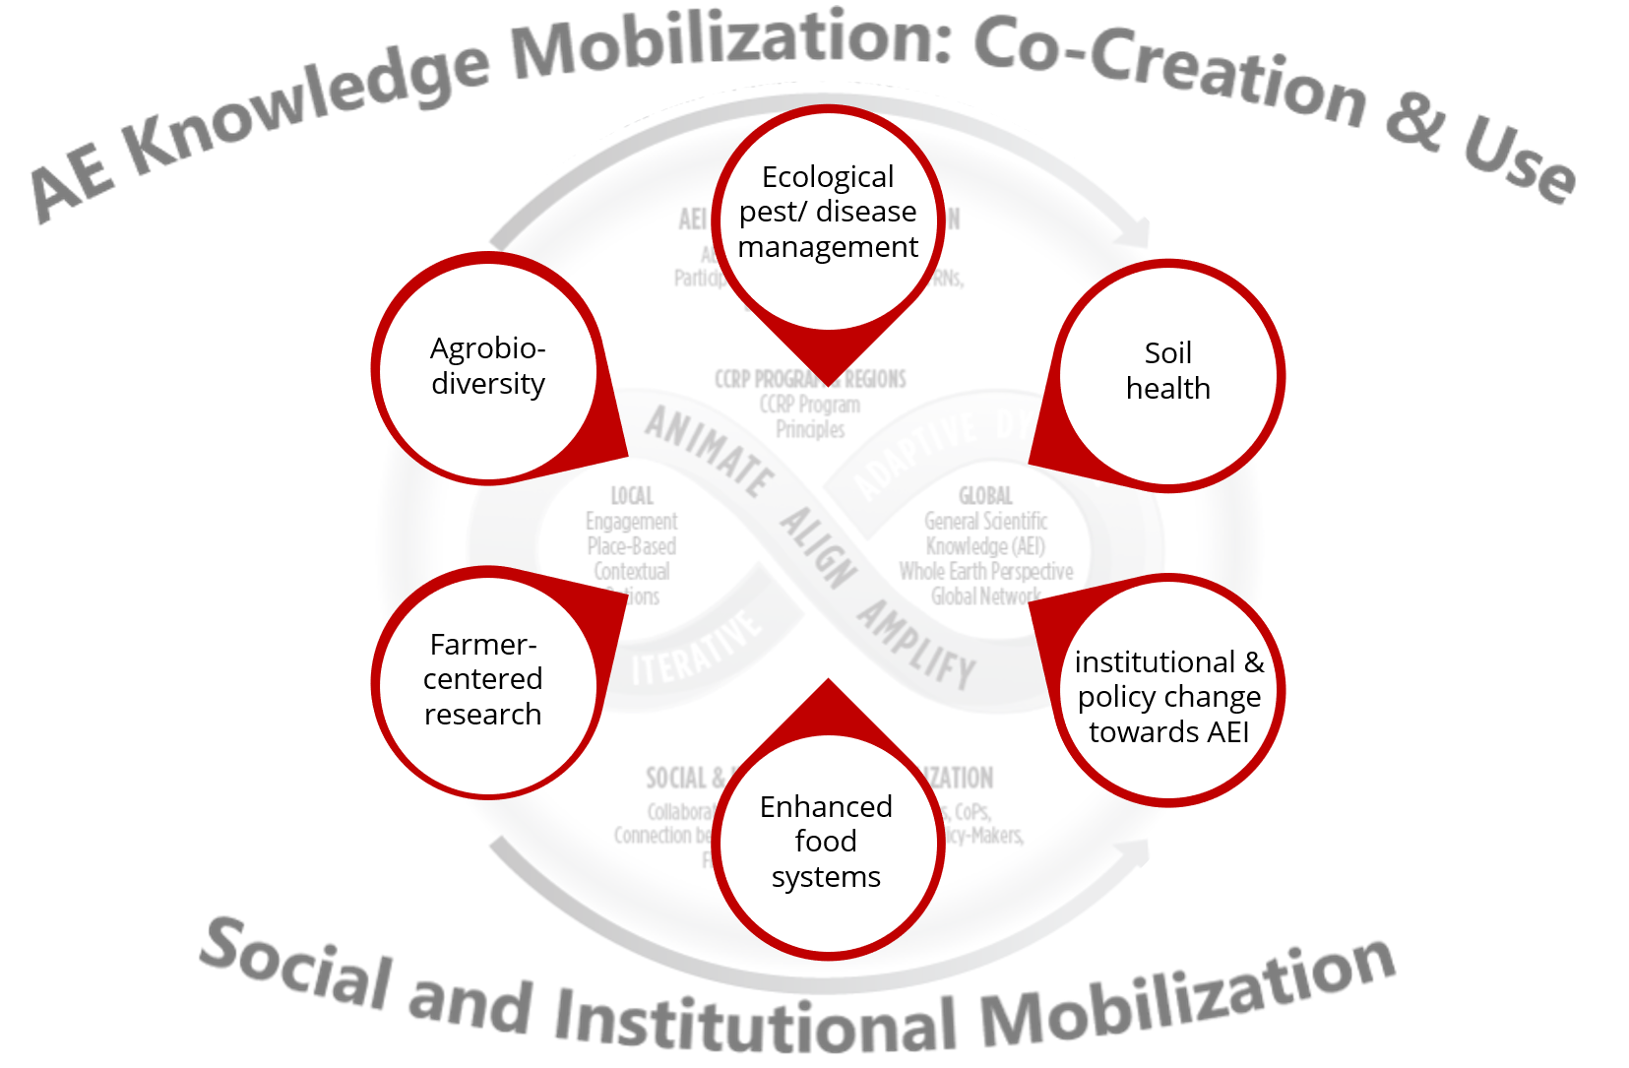
CCRP - 2020
External Context
Smallholder farming systems challenged by
Poor soil health, pest endemics, mycotoxins; aging farm populations, land subdivision, isolation…
Opportunities exist, but are constrained by resource limitations
Growing global interest in ecological solutions in agriculture
With differences in research priorities across science, practice and movement
Collaborative networks: Ag R+D orgs, FRNs, CoPs, funder alliances including climate-funders
A Quick Look:
10 countries in three regional Communities of Practice
72 CCRP projects
30 Farmer Research Networks (FRNs) and FRN-related projects
Regional Communities of Practice are maturing and remain key forums for project, region and program efforts
Thematic groups within & across regional CoPs and FRNs deepen understanding and practice
Strategic communications and knowledge management support connections and are being advanced across CCRP
TYPES OF ORGS
Farmer, Mrs. Jessica Florence Osire, selfing sorghum heads in Eastern Uganda. Photo credit: Charles Liri
WHAT | WHY
Advancing a program-wide capacity development strategy | To strengthen and ensure long-term sustainability of regional CoPs and agroecological research quality and innovation
Facilitate virtual linkages | To lower the cost ($ and carbon) for inclusive collaboration
Common support for research methods, gender, leadership and communications | To strengthen and advance capacities for quality leadership in Ag R+D
Promote leadership development of young scientists | To build long-term capacity within the field to continue work towards agroecological transitions, within and beyond the scope of CCRP’s influence
Dr. Omari Mponda of Naliendele Research Institute in Tanzania, with groundnuts. Photo credit: Groundnuts Project Team
Central Ecuadorian farmers. Photo credit: unknown.
How can CCRP align its work with global agroecological frameworks to assess progress and influence on larger scale change?
How are regional and XC grant portfolios and CoPs contributing to AEI trajectories?
What are FRNs learning from one another by exploring diversity and convergence while fulfilling principles?
How can linking with complementary efforts enhance and amplify effectiveness?
FRNs are growing, with diverse models for leadership, structure and scope. The principles have been profoundly useful as a guide as we advance.
Topical groups advance ideas during annual RM meetings and use WhatsApp to keep discussions rolling the rest of the year.
Energizing investments have included
Research methods support on AEI themes and FRN stages
Leadership training
Support for Internet connectivity in regional hubs.
Supporting and agroecology knowledge hub with FAO has expanded reach of AEI

