Slide 1

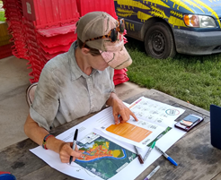
The Agroecological Transformation/Transition
Ernesto Méndez, Nils McCune y
Gabriela Bucini
Agroecology Support Team (AES) of CCRP
Notes:
Name and affiliation, trying to be efficient 10 minutes? End by 3:10

Slide 2

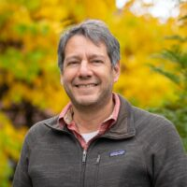
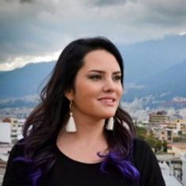
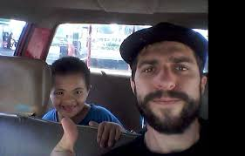
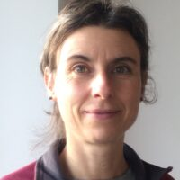
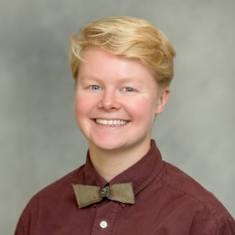
Agroecology Support Team (AES)
V. Ernesto Méndez
Project Lead
Co-Director Agroecology and Livelihoods Collaborative
Amaya Carrasco
PhD student
Nils McCune
Research Associate
Gabriela Bucini
Project Co-Lead
Nell Carpenter
AE Support
Notes:
Ernesto: He is Project Lead, Agroecology Support to the Collaborative Crop Research Program (CCRP). He also co-directs the Agroecology and Livelihoods Collaborative (ALC) at the University of Vermont. His research and teaching focus on agroecology, agrifood systems. He has over 25 years of experience working with smallholder farmers and Indigenous communities in Latin America, and collaborating in agroecology efforts in a wide diversity of regions.
Gabriela: I’m the project co-lead. I’m an ecologist and had the first chance to see and work in African savannas 15 years ago in South Africa. The local people taught really about savannas and ecological relationships. I’m most grateful for what they shared with me. I also worked in Guinea Bissau where locals were mapping their forest and fields. That is where I saw Agroecology at work and inspired me.
Nils: Is a research associate. For nearly a decade, he has worked with the international peasant movement, La Vía Campesina (LVC), to support the construction by LVC member organizations of agroecological territories in Latin America.
Ava: Program Coordinator, Agroecology and Livelihoods Collaborative and AE Support to Collaborative Crop Research Program (CCRP). She has over 4 years of farming experience ranging from diversified vegetable production to poultry to cow and goat dairy. Ava is an Instructor at UVM’s Farmer Training Program, a 6-month intensive course for new and beginning farmers held at the University’s own Catamount Farm

Slide 3
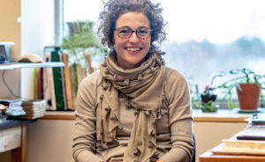

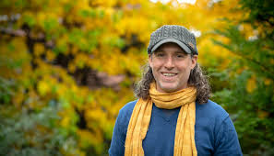

UVM SUPPORT TEAM
Martha Caswell
Taylor Ricketts
Victor Izzo
Rachelle Gould

Slide 4


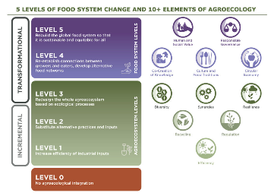

Objectives of the AES
To deepen and advance the Co-Learning in Agroecology.
To advance the analysis and monitoring of agroecological performance
  Critical review of agro-ecological principle and performance frameworks
  Critical review of agroecological research methods (together with RMS)
  Aggregation/Analysis of agroecological performance at the program level
Coalesce Support Teams and Key CCRP Initiatives around Agroecology
Use Lessons Learned to Engage Diverse, Global Actors in a Dialogue that Advances Agroecology
Source: Biovision Agroecology Info Pool: https://www.agroecology-pool.org/

Slide 5
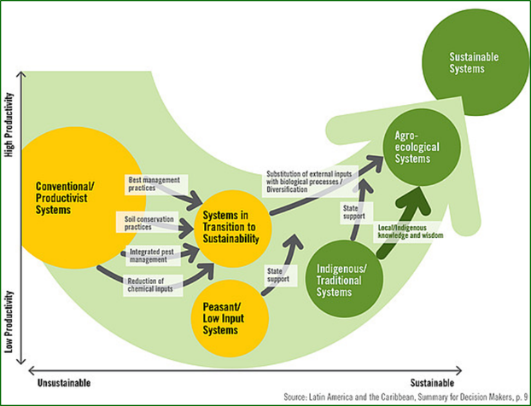
What is Agroecological Transformation / Transition?
Transform: to change completely the appearance or character of something or someone, especially so that that thing or person is improved.
(Cambridge Dictionary, 2020)
Transition: a change from one form or type to another, or the process by which this happens.
(Cambridge Dictionary, 2020)

Slide 6
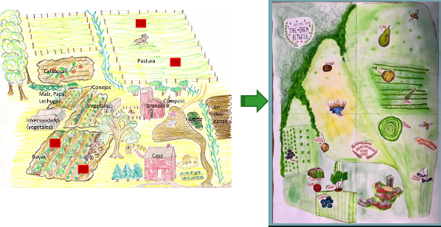
The Process of Transition or Agroecological Transformation:
Analysis and Monitoring
  Emphasis on process – “processes, not projects”
  How do you start - What is the starting point?
  How do you decide what the goal of the transition is?
  How do you choose and apply the tools to monitor and evaluate the process?
  What agroecological perspective are we using?

Slide 7
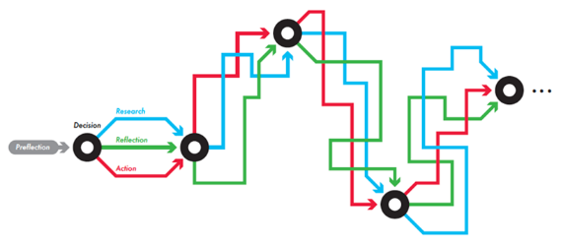
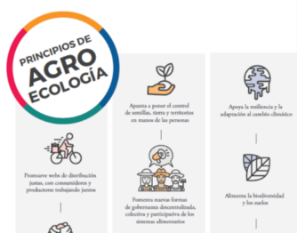
The Approach to analyzing and monitoring the transition process or agroecological
  In the ALC we use two main approaches to support the transition:
    PAR
    Tools/Approaches based on Agroecology Principles
  There is no one way to work or a "silver bullet".
    Actors
    Context
    Knowledge and Preferences
Participatory Action Research (PAR)

Slide 8
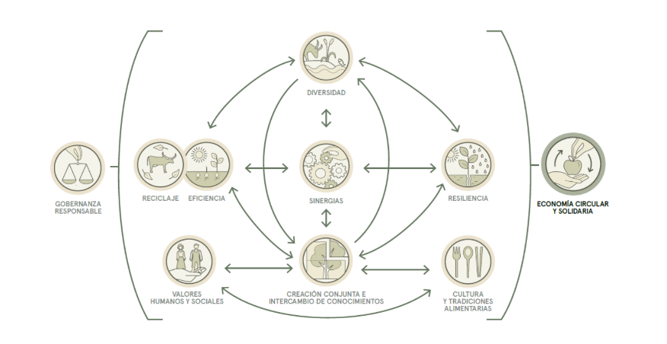
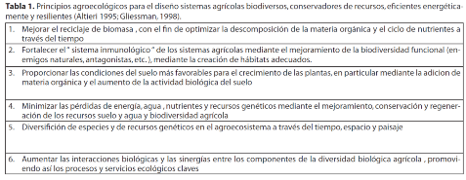
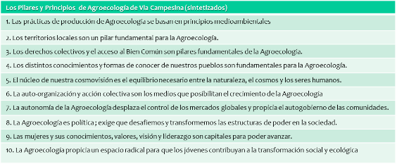
A variety of proposals of Agroecology Principles
Source: FAO (2018) The 10 elements of agroecology [free access]
Source: Nicholls, et al. (2015) Agroecología 10(1): 61-72 [free access]
Source: Boletín Nyéléni # 28, 2016: https://nyeleni.org/spip.php?rubrique177 [free access]
Source: CIDSE (2018) The principles of agroecology [free access]

Slide 9
Comparison among some proposals of Agroecological Principles
 | Bell & Bellon (2018) | CIDSE (2018) | Agroecology and Livelihoods Collaborative (ALC) | Nicholls, et al. (2016) | Elementos FAO (2018) | Vía Campesina 2016 Boletín Nyéléni # 28, 2016
Principios de Contexto | x |  |  |  | x | X
Principios Biofísicos/ Ecológicos | x | x | x | x | x | x
Principios Sociales/ Culturales | x | x | x |  | x | x
Principios Políticos | x | x | x |  | x | x
Principios Económicos |  | x | x |  | x
Modified table from source: María Yumbla (2019)

Slide 10
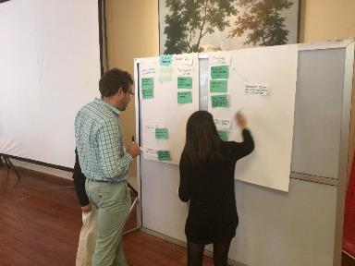
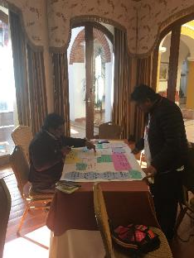
Exercise on Agroecological Principles at a Workshop in Arequipa, Peru, in 2017
Different types of organizations doing agroecological research - national and international
Frames: Gliessman, FAO, ALC
Five groups were formed and one individual.

Slide 11
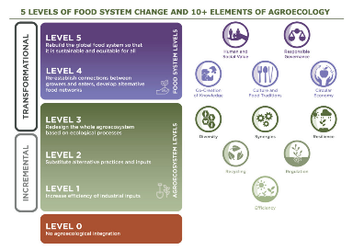

Tools for analyzing Agroecological Performance and Transition
Source: Biovision Agroecology Info Pool: https://www.agroecology-pool.org/
Petersen et al (2019) LUME Español; Inglés
Source: FAO (2019) TAPE [free access]
Source: FAO (2019) TAPE [free access]

Slide 12
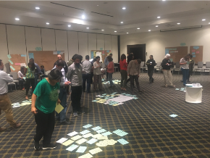
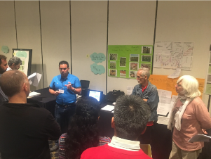
Regional Workshop on the Application of the Tool for Agroecology Performance Evaluation (TAPE). Food and Agriculture Organization of the United Nations (FAO).
6-8 November. Mexico City, Mexico. FAO and McKnight Foundation

Slide 13
Example of a transition analysis over time (before and after a project). Source: FAO (2019)

Slide 14
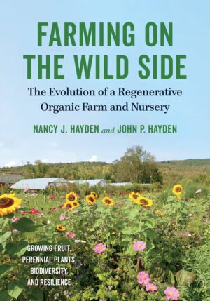
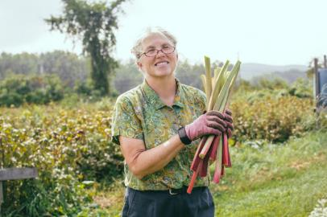
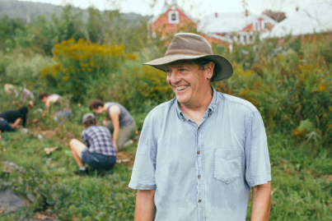
Example of agroecological transformation
Nancy and John Hayden

Slide 15
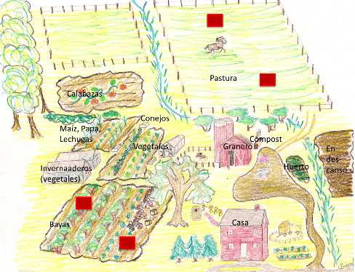
Example of agroecological transformation
Guiding AE Principles :
Diversity
Synergies
Efficiency
Resilience
Human and social values
2009 - Starting point:
Pasture
Annual crops
Few perennial berries
Direct Sales
2019: Present
Many perennial berries
Fruit trees
Berry and tree nursery
Pollinator habitats
Source: Students of the “Adavanced Agroecology” course (University of Vermont), years 2009, 2018 y 2019; Interview with E. Méndez

Slide 16
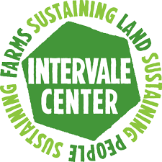




Case Study # 3:
Urban and Peri-urban Agroecology (UPAE) in Burlington Vermont, United States
Slide by Martha Caswell
Notes:
Name and affiliation, trying to be efficient 10 minutes? End by 3:10

Slide 17
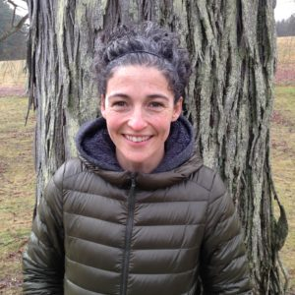
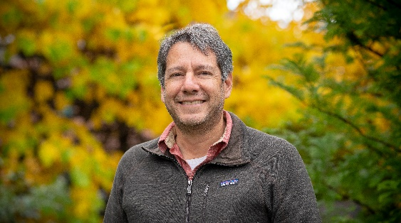
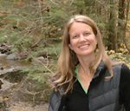
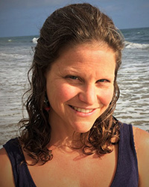
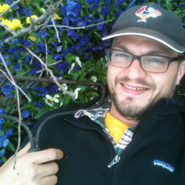
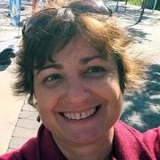
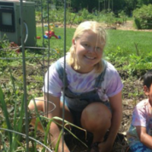
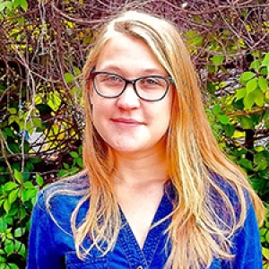
UPAE Team
Martha Caswell, Leader, ALC
Ernesto Méndez, Professor of Agroecology, ALC
Stephanie Hurley, Ecological Design Professor
Rachelle Gould, Professor of Environmental Studies
Josh Taylor, PhD student in Food Systems
Maria Juncos, PhD student, York University/ALC
Nell Carpenter, Environmental Studies student
Tatiana Gladkikh, PhD student in natural resources

Slide 18

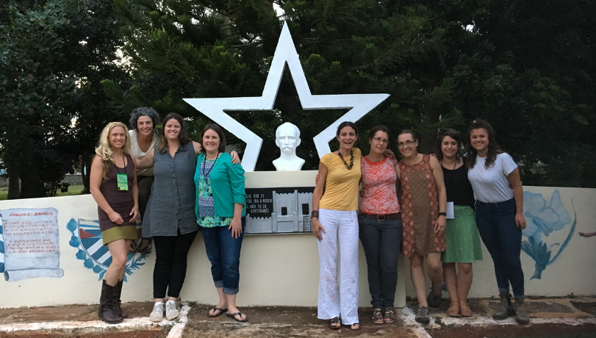
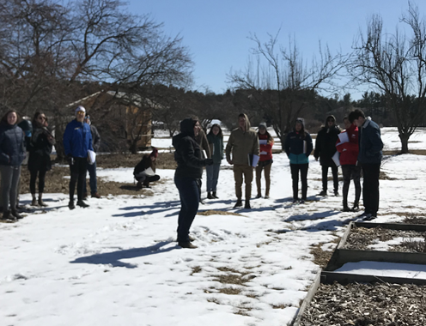
Process (2016-)
Collective definition (approximate of agroecology)
Selection of agro-ecological principles framework
Socialization workshops for all actors
Exchanges with Cuba on urban agroecology
Development of Research Questions and Methods

Slide 19

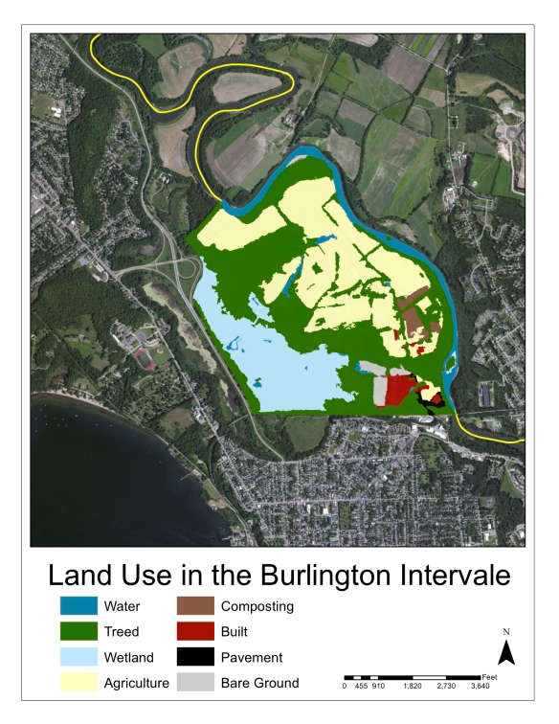
The Intervale: Description and Programs
Rescued" land - 252 ha, on the outskirts of Burlington
It became a non-profit organization in 1988
Mission to "strengthen community food systems
Programs:
  Farmers' Incubator
  Commercial properties
  Estate Planning
  Food Distribution Center
  Good land management
  Food for conservation (trees)
  Food rescue and gleaning
Notes:
5 min TG/RG, 5 min MJ/EM, 2 min repository/MC, comments from Patrick and Chelsea, done by 4

Slide 20
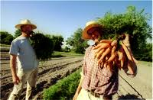
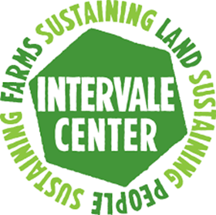
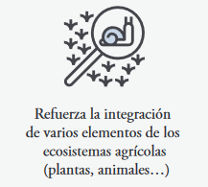
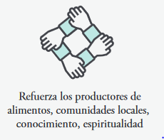
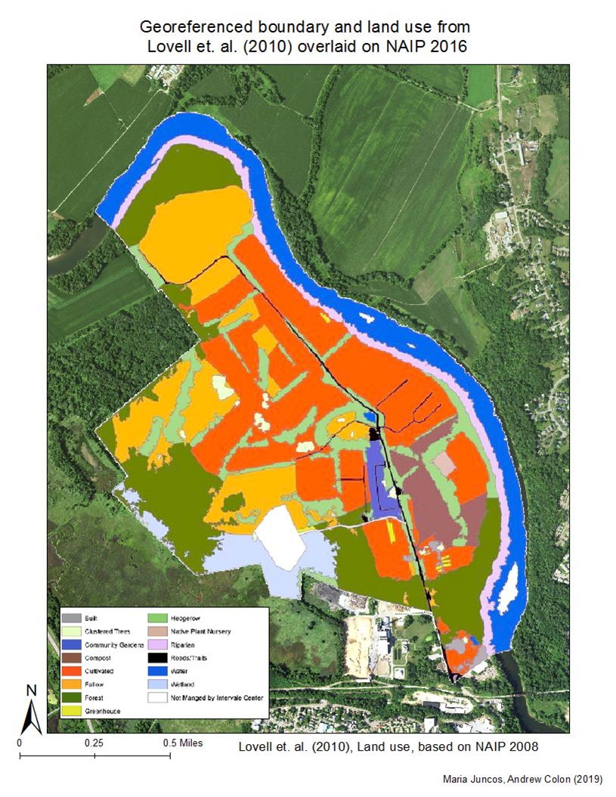
Principles
Agreed Activities on Agroecology
Inventory of agroecological principles by land use
Prioritization of principles
Project to design practices to support agroecological principles in 2019
Collective analysis
Next steps for the agro-ecological transition
En descanso
Agrícola
Cercas vivas
Bosque
Vivero Arboles
Humedal
Notes:
5 min TG/RG, 5 min MJ/EM, 2 min repository/MC, comments from Patrick and Chelsea, done by 4

Slide 21
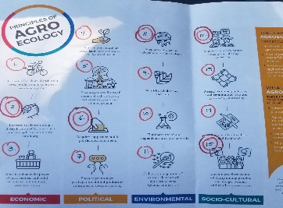
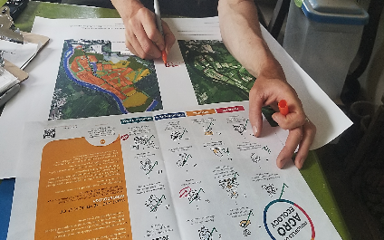
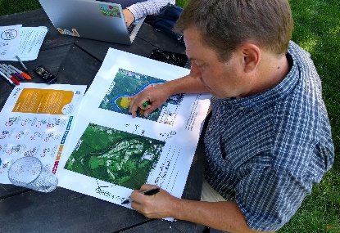
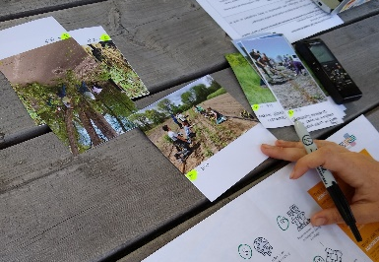
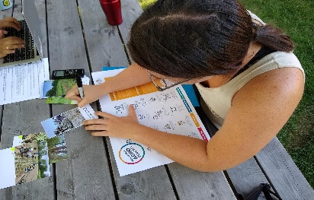
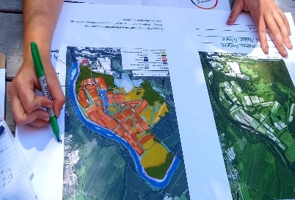
Qualitative Methods
1st round of interviews n=29 inventory of principles on map with key actors
1
2
3
Experience: education,
work,
years at Intervale
Identify the principles present using examples
Location of the principles on the map
2nd round of interviews n=18; 15 maps
1
2
3
Use of 'Photo Voice’
ID principles in photos Explain and give examples. Show on map

Slide 22
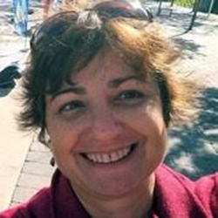
Maria Juncos,
PhD candidate,
York University

Slide 23

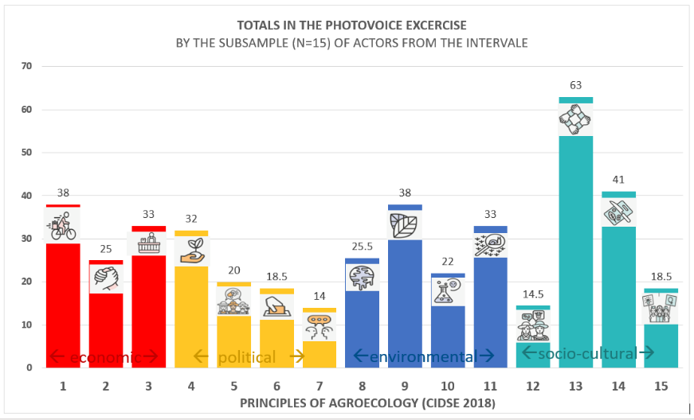



Inventories of Agroecological Principles at the Intervale [Triangulation Method ]
Photo Voice
Maps

Slide 24


Workshop of Reflection/Collective Discussion on Agroecological Principles
January, 2020

Slide 25


Next Steps for the Agroecological Transition
January, 2020
Prioritization of Principles
Actions

Slide 26


Questions?
Comments?
Thank you!!

