Slide 1
syntesis
Possible paths and future visions of Agroecology in the Andes
Group work
CoP16

Slide 2
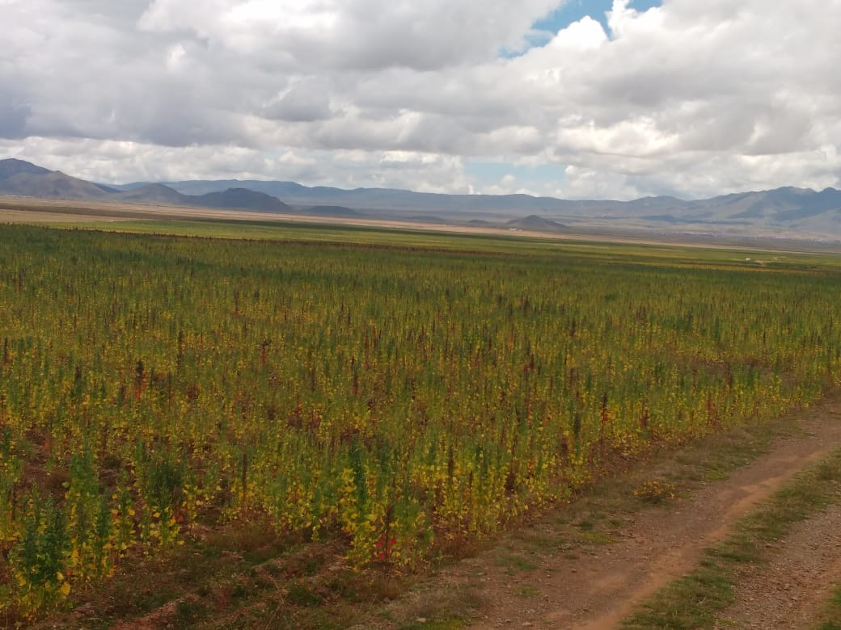
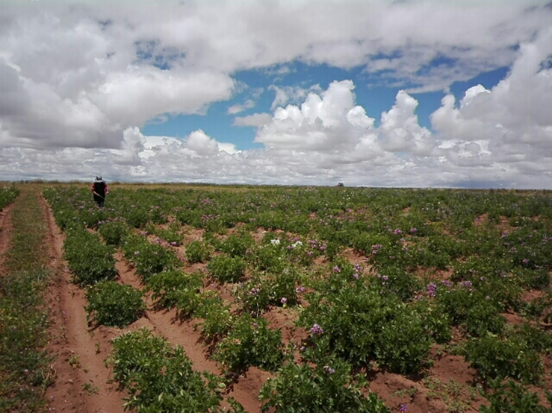
Vision
How you would like to see this agro-ecological territory

Slide 3
The Bolivian Plateau
The central zone of the Bolivian plateau is agro-ecological, with fertile soils and coverage, use of native seed diversity, use of bio-inputs for pest management, water management, and with local knowledge strengthened for food security and sovereignty.
An agroecological management of the territory in arid zones, with the commitment and participatory action of families and their social organizations, through the strengthening and construction of knowledge.
Central Ecuador
"That small producers are capable of sustainable production, generating surpluses to feed the population in a healthy way".
Resilient agroecological systems (COVID-19, Droughts)
Central Andes of Peru
More resilient agroecosystems with farmers who manage a range of options/knowledge, which fit the conditions of a context
A territory diversified in agricultural production systems and natural ecosystems, where the biocultural heritage and agrobiodiversity are preserved.

Slide 4
Socio-economic
Empowerment of farmers
Differentiated spaces for the supply of agro-ecological products
"Seed and agrobiodiversity“ holders
Conscious and motivated consumers buy AE products and have confidence in production (SPGs)
Farms with more AE components: water conservation, diversity of production and sources and income, basket marketing, barter, no GMO seeds
Demand for indigenous animal meat in cities
The crisis of the Pandemic forces us to face challenges;
Short marketing chains with greater opportunity for women and family
Strengthening participatory research
Maintaining biodiversity
Understanding and strengthening agroecological systems
Strengthen the connection between farmers' priorities and biophysical problems.
climate change.
More resilient agroecosystems
Science
Cultural/traditional
Thinking about the dialogue of knowledge (diálogo de saberes) not just technique.
Schools and children value/recognize local knowledge
Food Sovereignty
Cultural Resilience
Promote equality, inclusion, equity (gender, generational, ethnic)
AE Empowered Farmers
Andean Cosmovision
Movement
Practice
Making agroecology experiences visible
Water management: storage of rainwater for consumption and for agricultural activities
Diversification
Resource sovereignty
Technological innovations that improve conditions
"A high productivity without compromising our territory"
Revaluing native animals from the upper floor
Healthy soils, efficient use of organic inputs to maintain the agricultural frontier without expanding it into the highlands.
Relationship between protected areas and communities allows the maintenance of livestock
Policy
Participatory sustainable local development
Agroecological regulatory framework
Strengthening resilience among multiple actors: Concurrence of central, municipal, and community actors for integrated solutions
Supporting farmers' associations to influence local ordinances.
Strengthened/consolidated local organizations
Adequate government policy; competition with mining interests

Slide 5
Socio-economic
Pandemic
Short marketing chains
Markets: differentiated spaces for the supply of agro-ecological products
Biodiversity
Climate change.
Resilience of agrosystems
Science
Cultural/tradicional
Food Sovereignty
Cultural Resilience
Valuing local knowledge + Schools
Equality, inclusion, equity (gender, generational, ethnic)
Farmers (women + youth) empowered by AE
Movement
Practice
Resource sovereignty
Healthy soils, efficiency
Water management: rainwater storage
Diversification
Policy
Support farmers' associations to influence local ordinances.

Slide 6
Sovereignty
Resource sovereignty: Agrobiodiversity maintained, valued and managed appropriately
*Prestige of local knowledge
2. Food sovereignty: Healthier crops and breeds that provide healthy nutrition
3. Individual's own sovereignty: children and young people empowered using agriculture as an option to improve their quality of life.

Slide 7
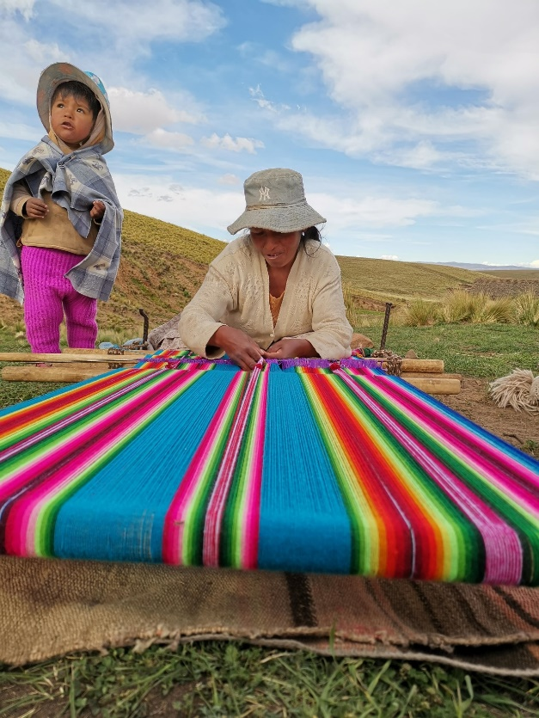
Considerations on the vision
It is a process under construction
The vision is built by the actors who are going to make the changes in the territories:
producers, community, politicians, family, is what will define where AE is going.
There is no single vision of AE in the territory.
Refine the different visions of the actors
Common language

Slide 8
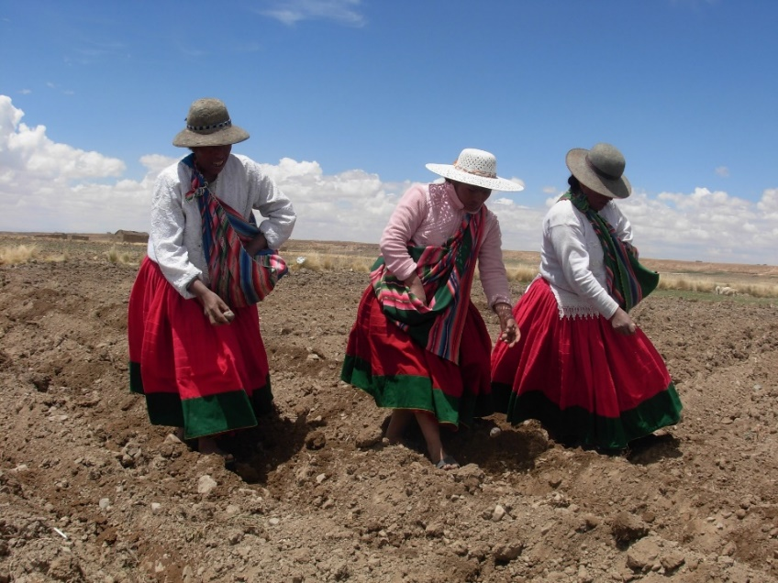
Steps and action
Aspects to be considered:
Establish the scale
Where do we start in the transition?
Theoretical conceptual basis of how change occurs
Contextual factors that help in the AE transition
Steps to be followed:
Participatory Diagnosis: situation in each territory
Building farm dreams, capital and gap analysis.
Defining actions for transformation
Move forward with small, realistic steps taking into account the situation of each community/territory.

Slide 9
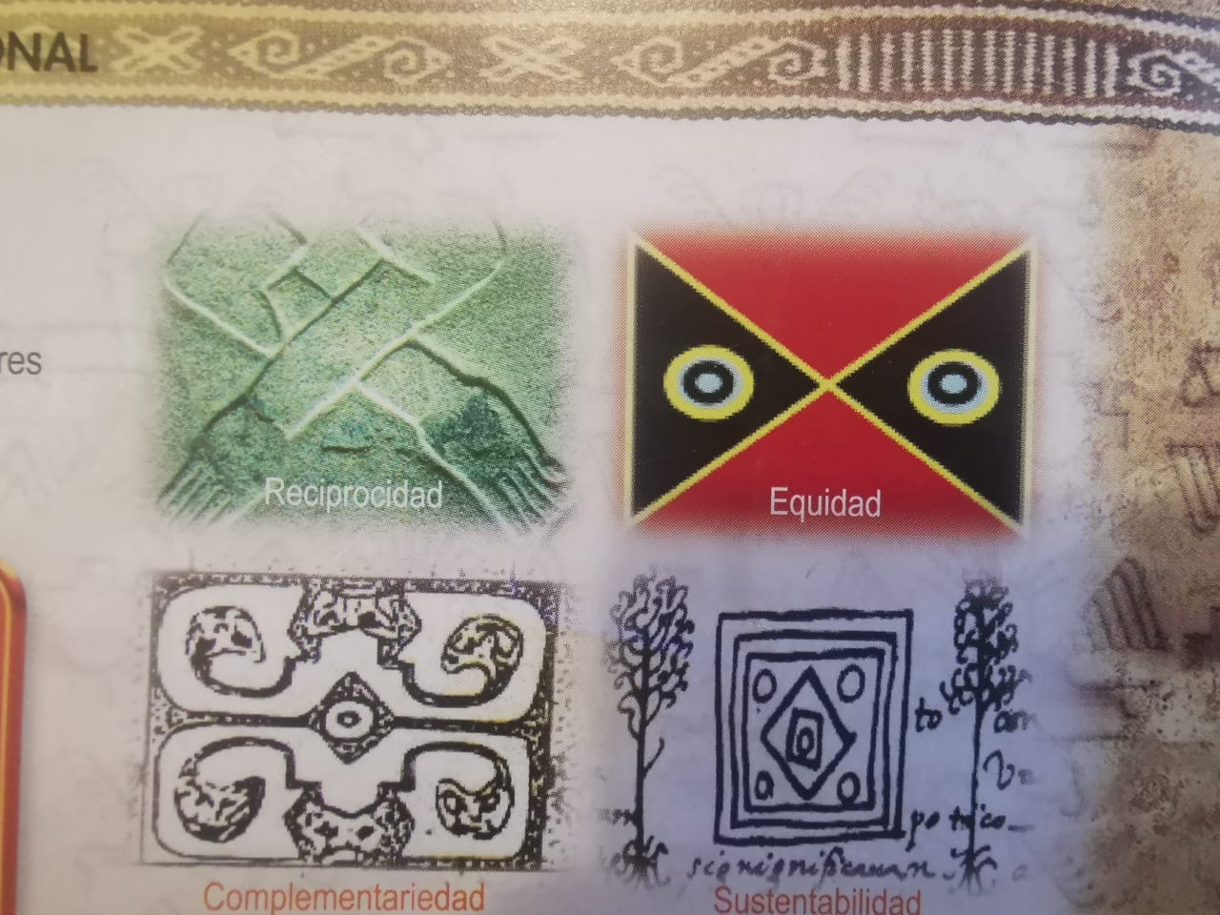
What principles help to realize this vision?

Slide 10
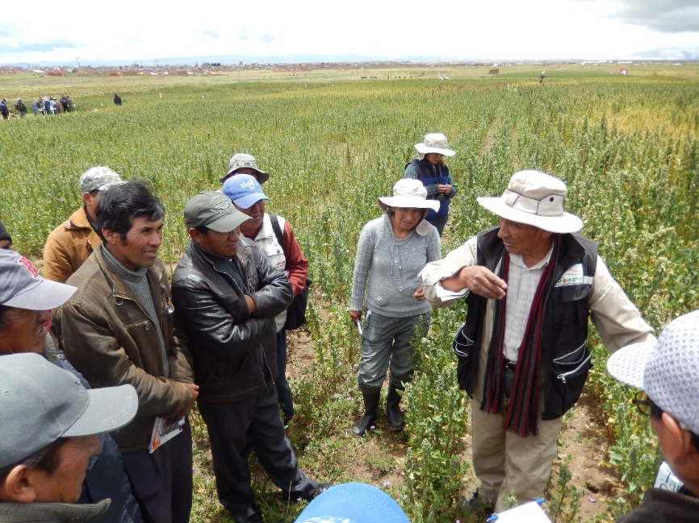
The principles are for guidance...
Transformation at the level of the person, of the family that has to do with values and social capacities; then at the level of the farm and communities
The ability to generate questions and observe systematically
Internalize changes
Harnessing People's Capabilities

Slide 11
BIOPHYSICAL/ECOLOGICAL:
conservation and restoration of ecosystem components (e.g., biodiversity, soils, water, air)
Diversity (cultivated, wild species)
Efficient use of resources
Recycling (organic inputs)
CROSS-SECTIONAL/CONTEXTUAL:
Equity:
intergenerational
Gender
Ethnic
local context (biophysical, socio-economic...)
Reciprocity, identity, complementarity
Sustainability
Principles
POLICIES
Governance and participatory management
Responsible governance
SOCIO/ECONOMIC
Health and healthy eating, education, appreciation of rural life.
Economic strength, creation of social capital through networking
Marketing is about reciprocity not solidarity
Collective work (collective action) in marketing
Role of subsidies well thought out
Circular Economy
Fair trade (fair prices)
CULTURAL/SOCIAL:
Respect for local knowledge and cultural identity
Creation and sharing of knowledge
Awareness of organic food production
Cooperation
Caring for the people we interact with (COVID-19, Yanomamis)
Decolonizing approach
Solidarity and humility

Slide 12
Besides a peasantry with land, what factors are needed for agroecology to exist in this territory or for existing agroecologies to be maintained and strengthened? How do these factors interrelate?
TOPIC | SIMILITUDES | DIFFERENCES/DISCUSSION | CHALLENGES
Governance | Important for everyone | Incorporation of AE vs. resistance to anti-AE policies Scales - regional vs. national | Prioritization
Markets | Mentioned by the majority | Urban Consumers/markets Local consumers/markets | - We have to do both
Local expertise/knowledge | Mentioned by the majority | Recognize Preserve Integrate with science/technology Passing on to new generations | Science and technology can overcome local knowledge They are getting lost
Tecnologías | - Mentioned by the majority - Locally adapted |  | Interaction with the local Who brings the technologies? How do you make sure they are adequate?

Slide 13
How could the principles of humility, solidarity, equity, dialogue of knowledge, and sovereignty, among others, be strengthened?
TOPIC | DISCUSSION | CHALLENGES
Principles of the Andean Cosmovision | Integration of the Andean Cosmovision with Science, other knowledge Avoiding technocentrism | Power Dynamics Communication - dialogue of knowledge (diálogo de saberes) Attitudes
Complementarity | We need each other City and country dialogue | Real inclusion of local actors Power Dynamics Communication - dialogue of knowledge Attitudes
Local Empowerment/Pride | Recognition of principles and values of the Andean cosmovision | Power Dynamics hierarchies
Respect | Important along with humility and solitude Pride and culture Identity Horizontal conversations | Power Dynamics hierarchies
Governance | Change of attitude of local and institutional actors Greater participation and inclusion Local empowerment Collective rights and access to common goods Citizen participation Associative networks | Power Dynamics Alternative Governance Political processes Organization

